Slide 1

제19강 레이아웃설계(2)
다양한 레이아웃에서 버튼 뷰와 테스트 뷰를 활용한 실습
학습 목표
레이아웃의 기본 속성을 이해한다.
다양한 종류의 레이아웃의 특성을 익힌다.
뷰와 연계된 안드로이드 레이아웃 설계를 이해한다.

Slide 2
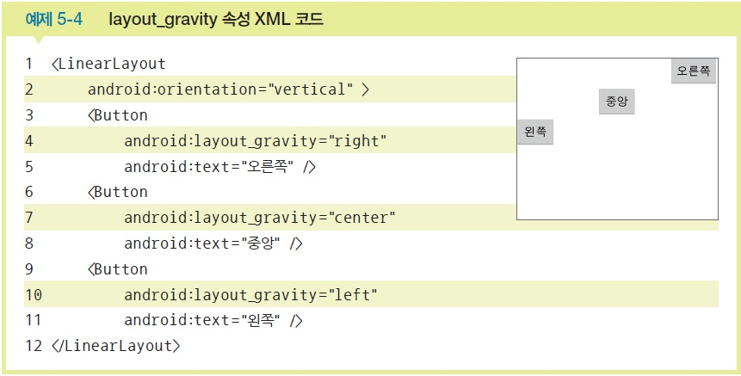
layout_gravity 속성
layout_gravity는 자신의 위치를 부모의 어디쯤에 위치시킬지를 결정

Slide 3
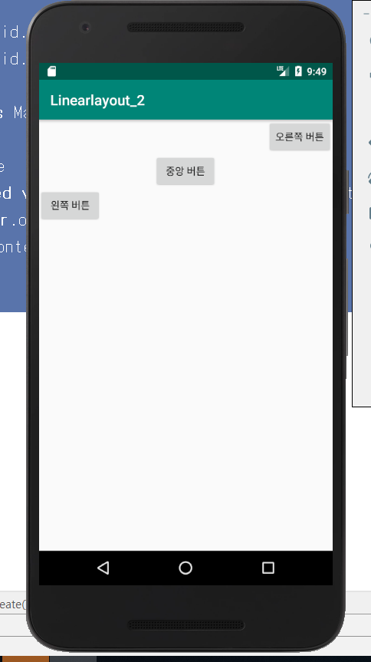
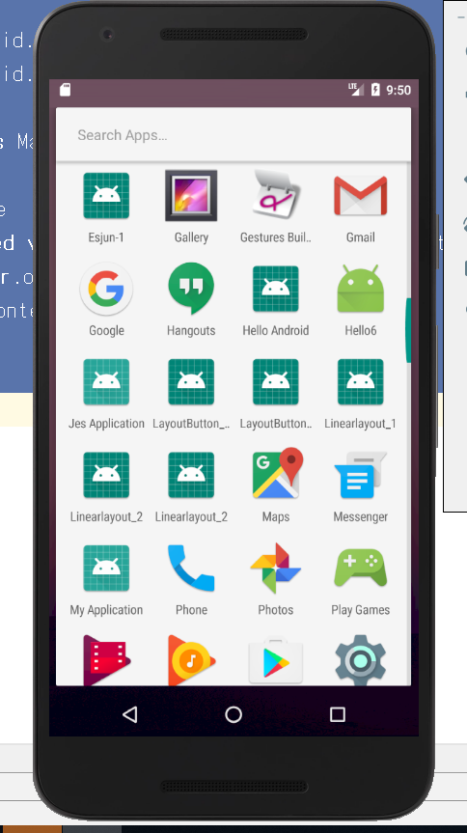
리니어Layout설계실습-4
텍스트와 버튼뷰를 gravity속성으로 배치

Slide 4
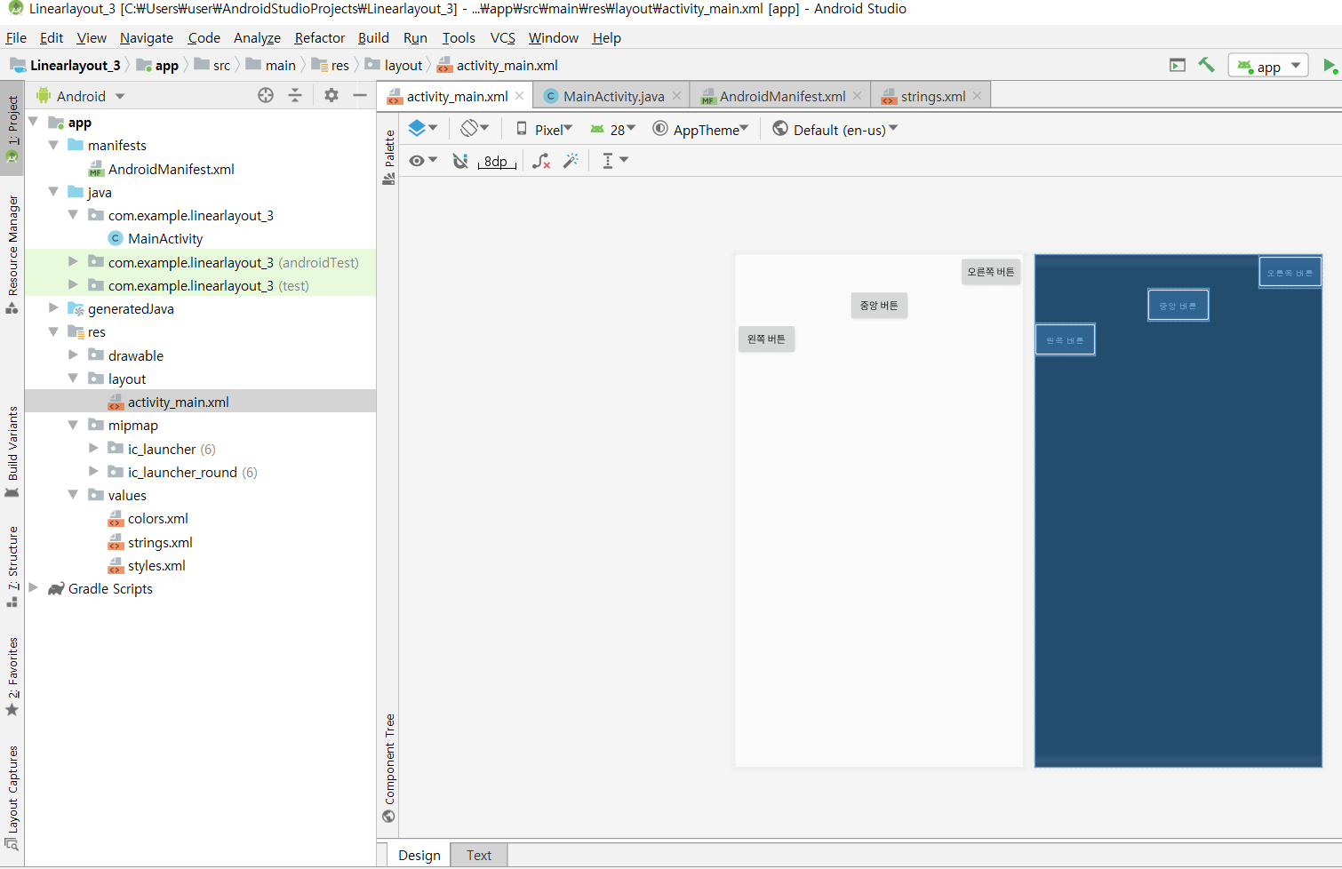
[activity_main.xml]

Slide 5
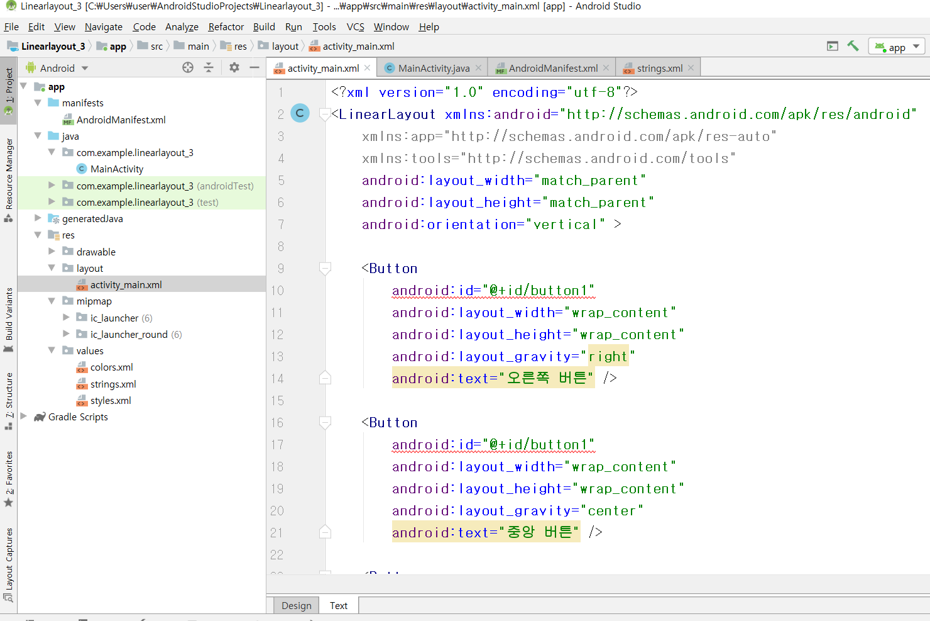

Slide 6
[activity_main.xml]
<?xml version="1.0" encoding="utf-8"?>
<LinearLayout xmlns:android="http://schemas.android.com/apk/res/android"
xmlns:app="http://schemas.android.com/apk/res-auto"
xmlns:tools="http://schemas.android.com/tools"
android:layout_width="match_parent"
android:layout_height="match_parent"
android:orientation="vertical" >
<Button
android:id="@+id/button1"
android:layout_width="wrap_content"
android:layout_height="wrap_content"
android:layout_gravity="right"
android:text="오른쪽 버튼" />

Slide 7
<Button
android:id="@+id/button2"
android:layout_width="wrap_content"
android:layout_height="wrap_content"
android:layout_gravity="center"
android:text="중앙 버튼" />
<Button
android:id="@+id/button3"
android:layout_width="wrap_content"
android:layout_height="wrap_content"
android:layout_gravity="left"
android:text="왼쪽 버튼" />
</LinearLayout>

Slide 8
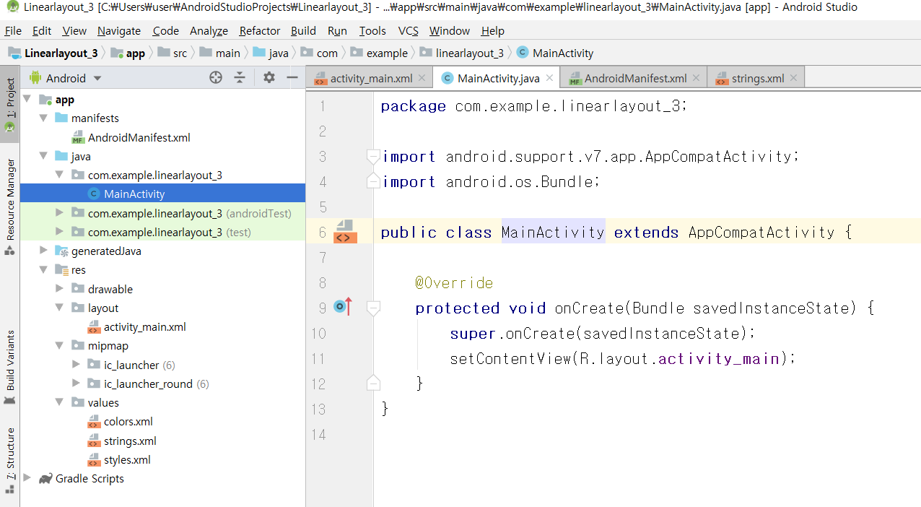
[MainActivity.java]

Slide 9
[MainActivity.java]
package com.example.linearlayout_3;
import android.support.v7.app.AppCompatActivity;
import android.os.Bundle;
public class MainActivity extends AppCompatActivity {
@Override
protected void onCreate(Bundle savedInstanceState) {
super.onCreate(savedInstanceState);
setContentView(R.layout.activity_main);
}
}

Slide 10
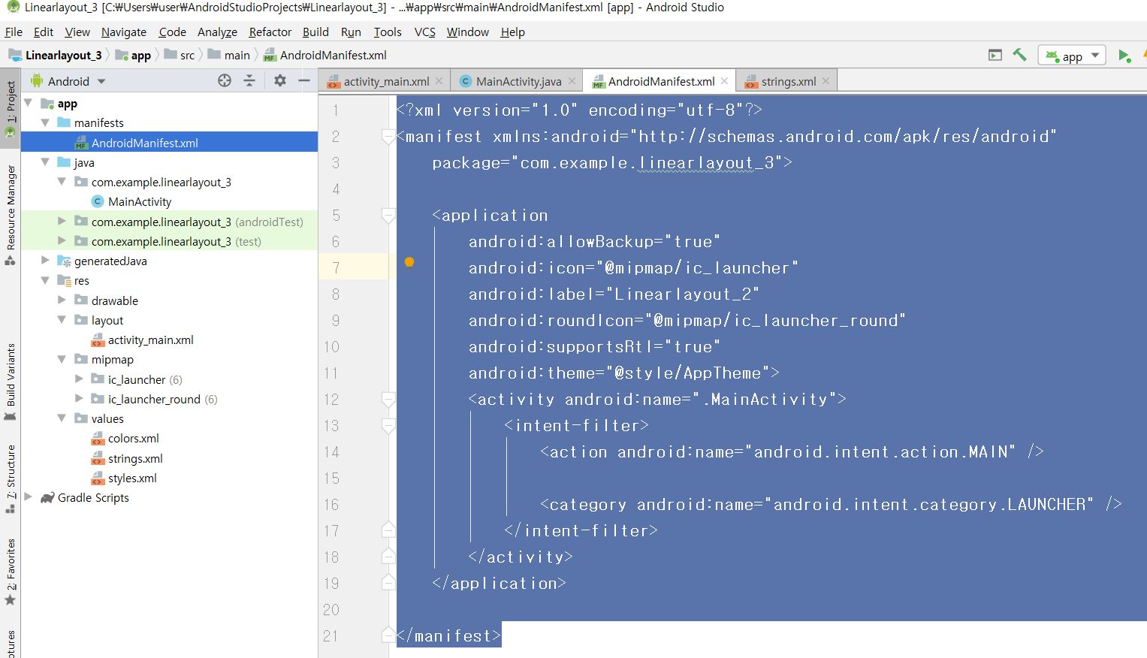
[AndroidManifest.xml]

Slide 11
<?xml version="1.0" encoding="utf-8"?>
<manifest xmlns:android="http://schemas.android.com/apk/res/android"
package="com.example.linearlayout_3">
<application
android:allowBackup="true"
android:icon="@mipmap/ic_launcher"
android:label="@string/app_name"
android:roundIcon="@mipmap/ic_launcher_round"
android:supportsRtl="true"
android:theme="@style/AppTheme">
<activity android:name=".MainActivity">
<intent-filter>
<action android:name="android.intent.action.MAIN" />
<category android:name="android.intent.category.LAUNCHER" />
</intent-filter>
</activity>
</application>
</manifest>

Slide 12
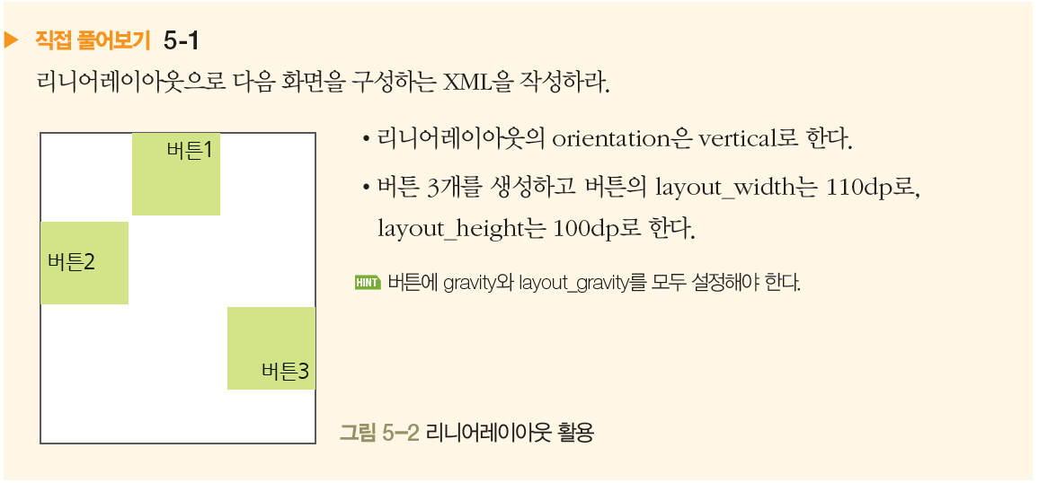
실전 실습과제

Slide 13
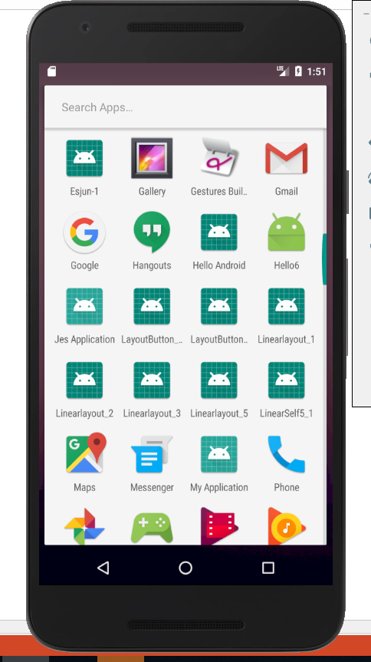
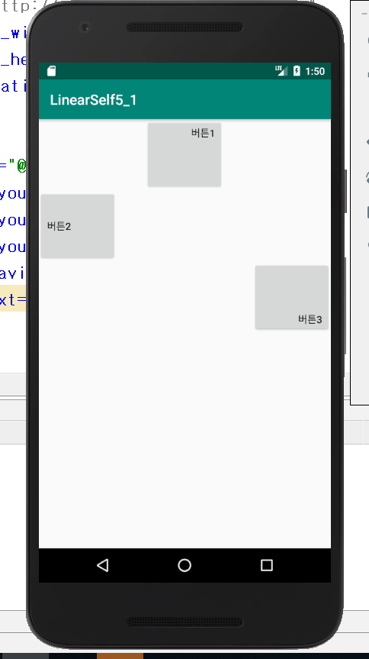

Slide 14
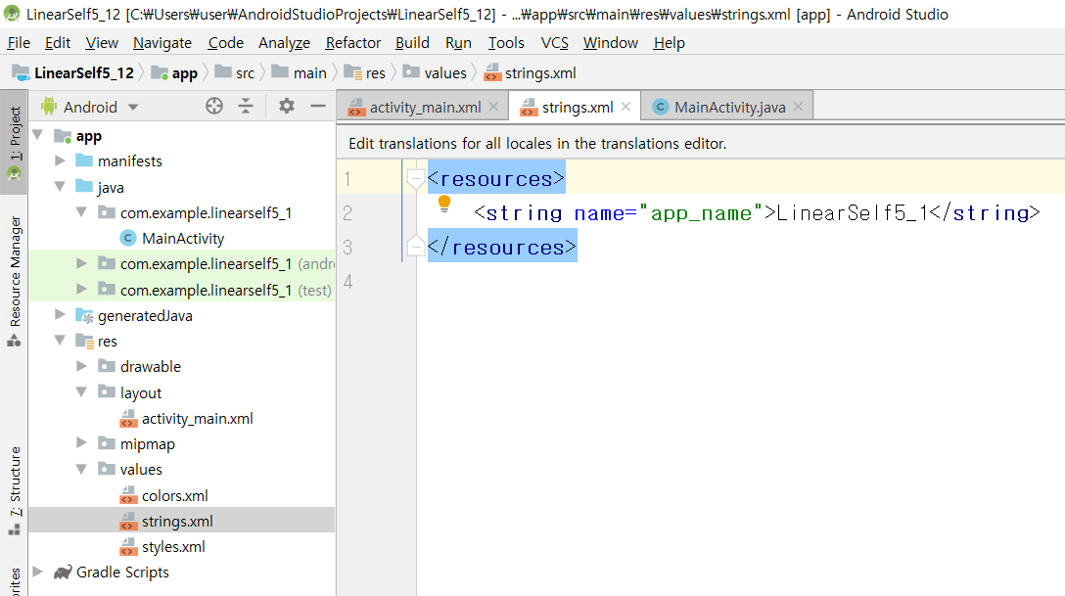
[string.xml]

Slide 15
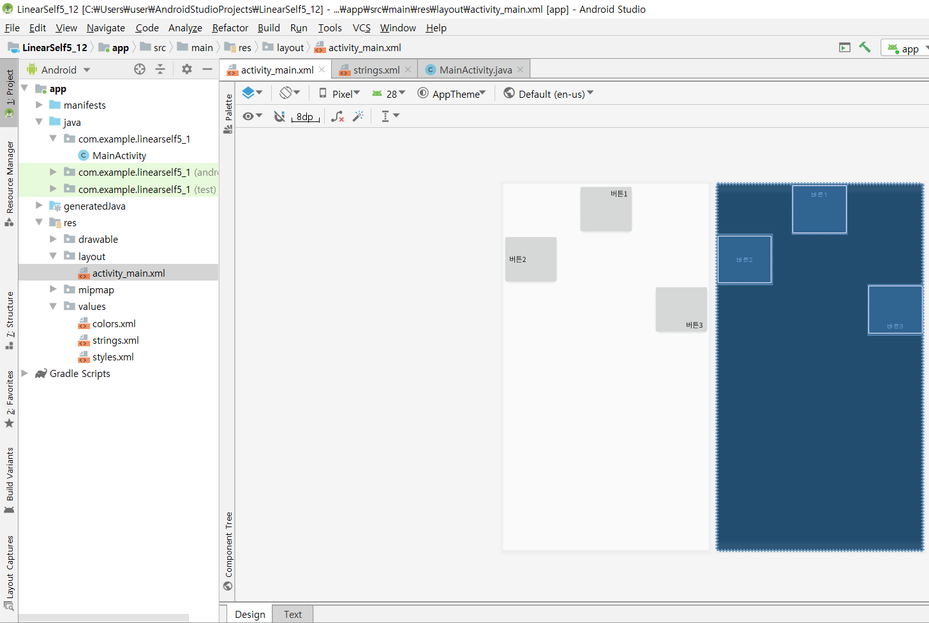
[activity_main.xml]

Slide 16
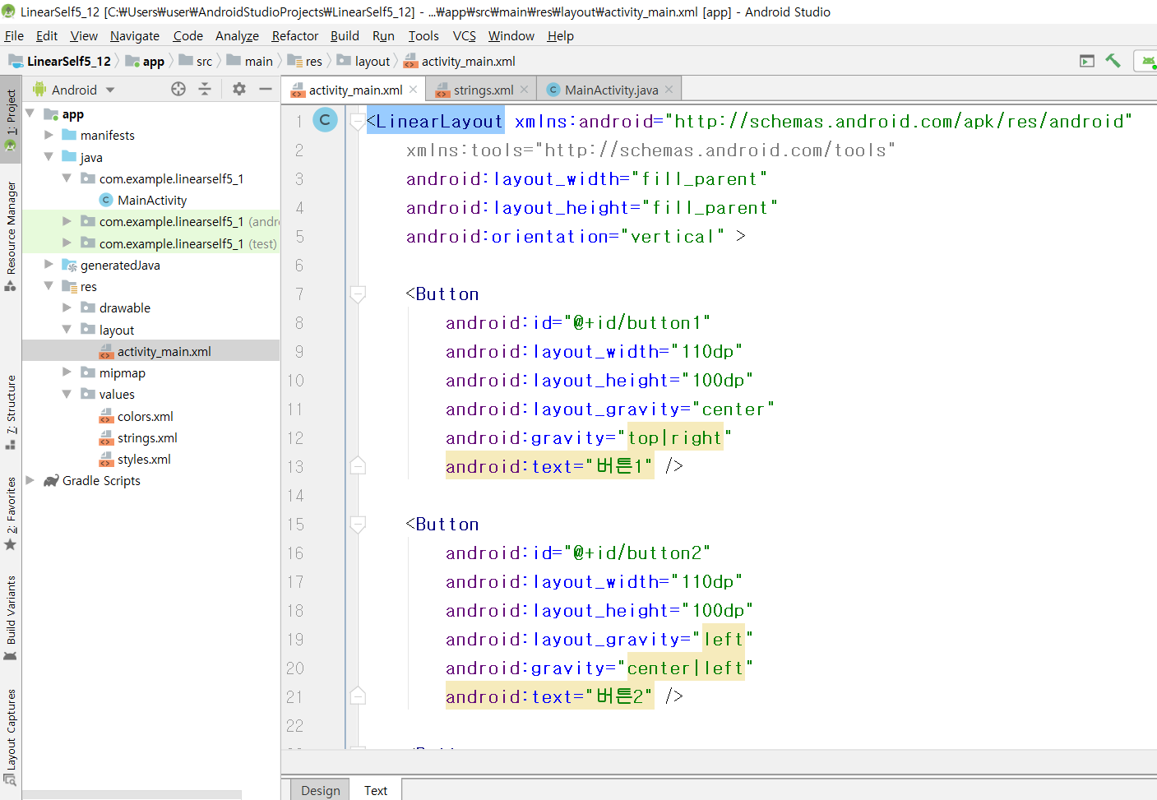

Slide 17
<LinearLayout xmlns:android="http://schemas.android.com/apk/res/android"
xmlns:tools="http://schemas.android.com/tools"
android:layout_width="fill_parent"
android:layout_height="fill_parent"
android:orientation="vertical" >
<Button
android:id="@+id/button1"
android:layout_width="110dp"
android:layout_height="100dp"
android:layout_gravity="center"
android:gravity="top|right"
android:text="버튼1" />
<Button
android:id="@+id/button2"
android:layout_width="110dp"
android:layout_height="100dp"
android:layout_gravity="left"
android:gravity="center|left"
android:text="버튼2" />
<Button
android:id="@+id/button3"
android:layout_width="110dp"
android:layout_height="100dp"
android:layout_gravity="right"
android:gravity="bottom|right"
android:text="버튼3" />
</LinearLayout>

Slide 18
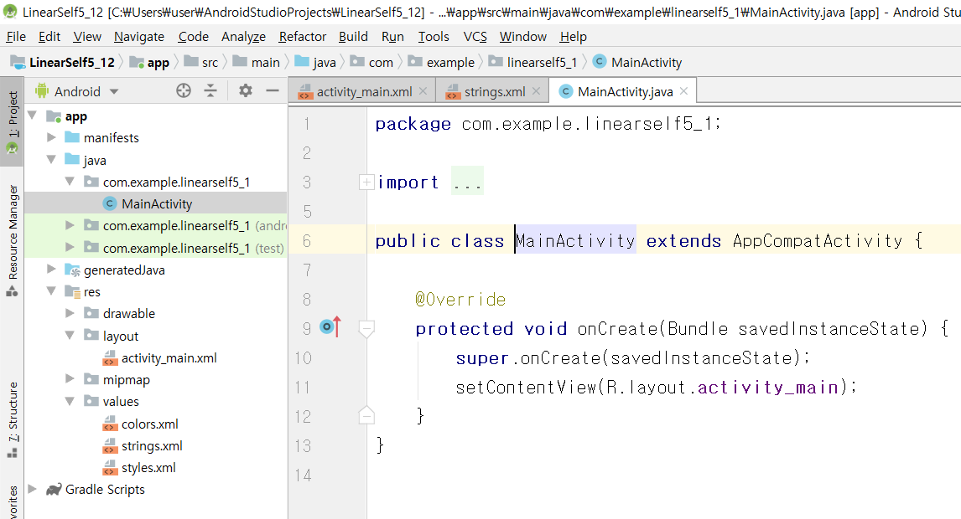
[MainActivity.java]

Slide 19
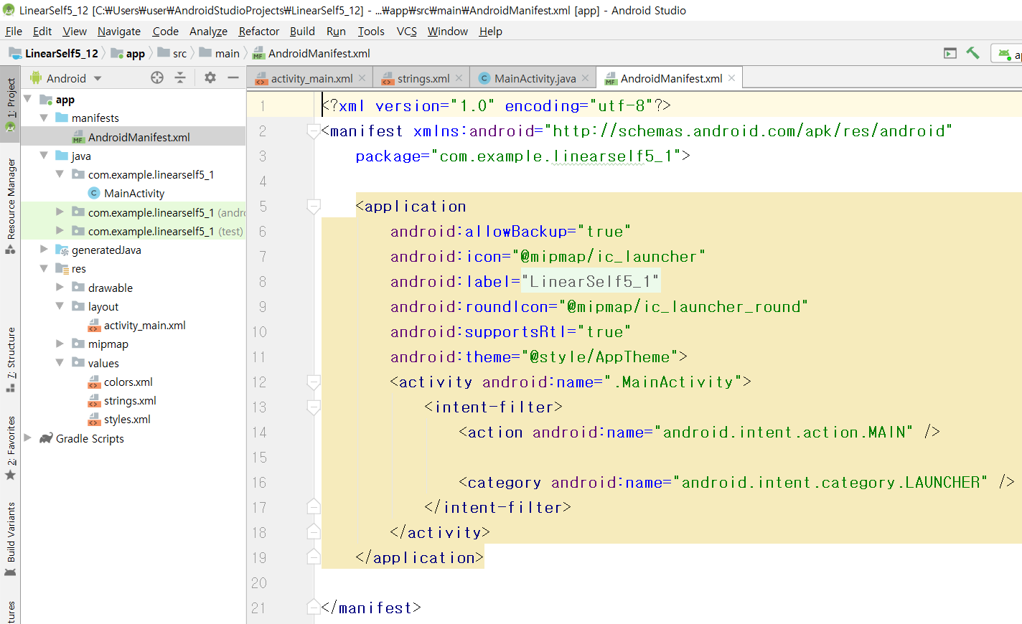
[AndroidManifest.xml]

Slide 20
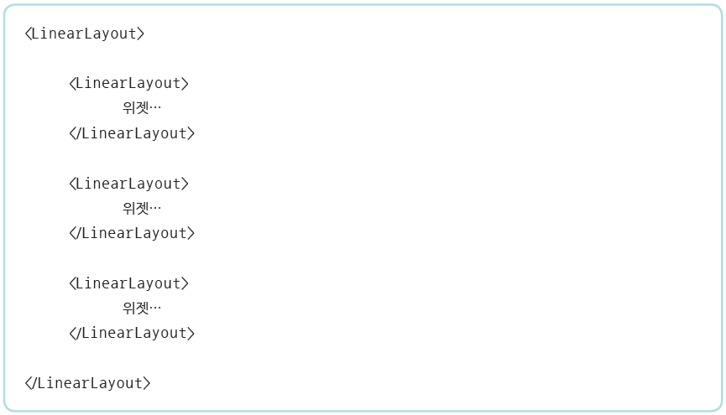
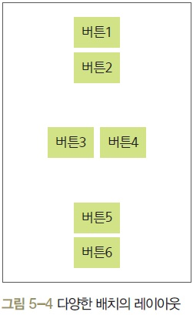
중복 리니어레이아웃 형태

Slide 21
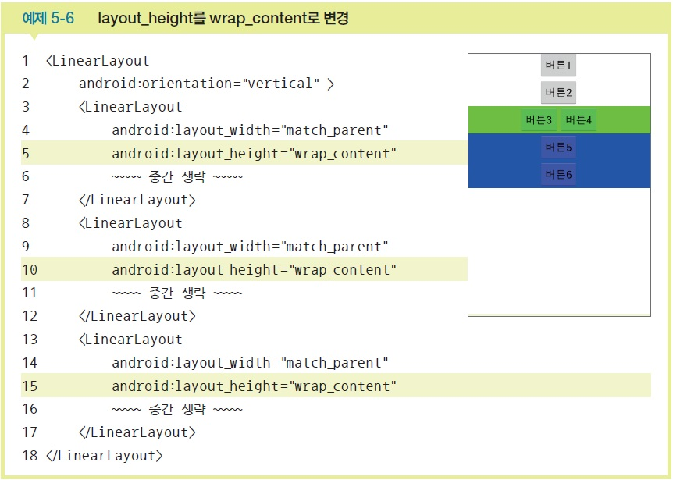
layout_height를 wrap_content로 변경

Slide 22
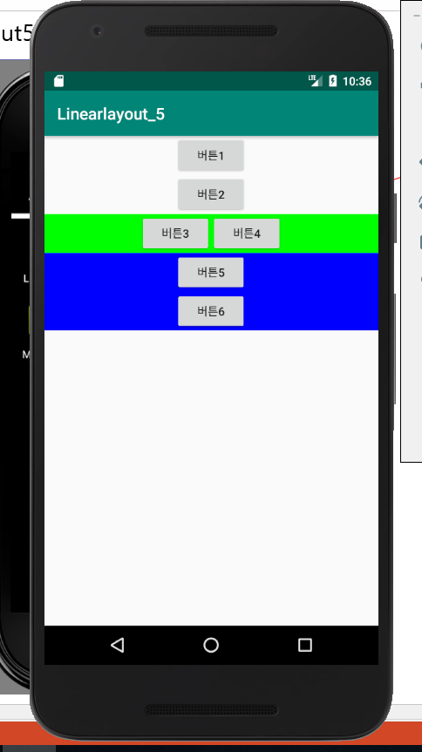
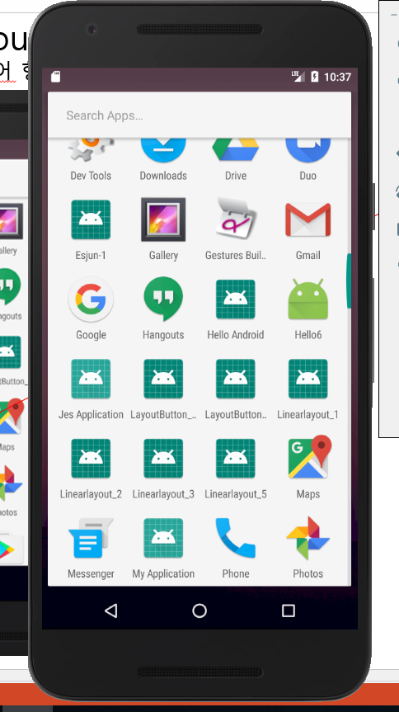
리니어Layout설계실습-5
중복리니어 형태로 배치

Slide 23
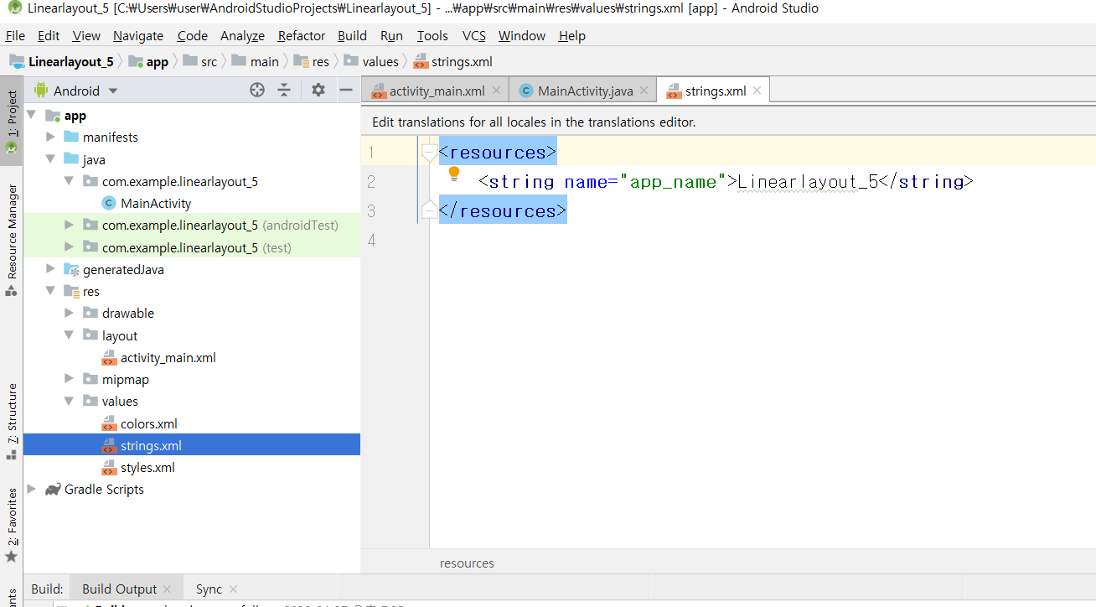
[string.xml]

Slide 24
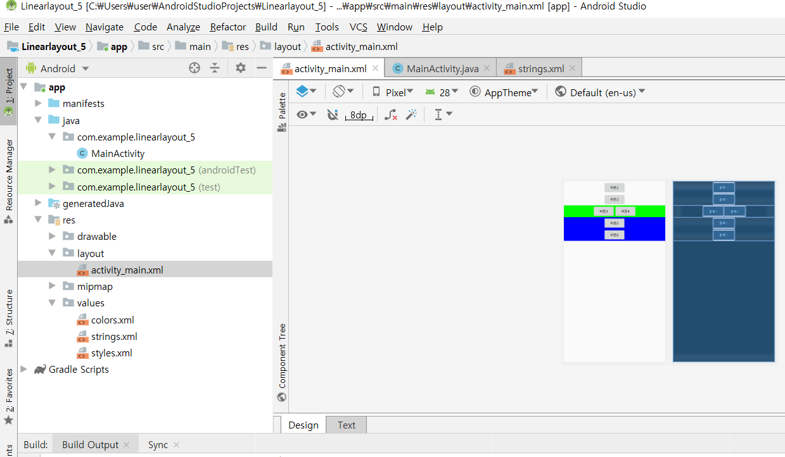
[activity_main.xml]

Slide 25
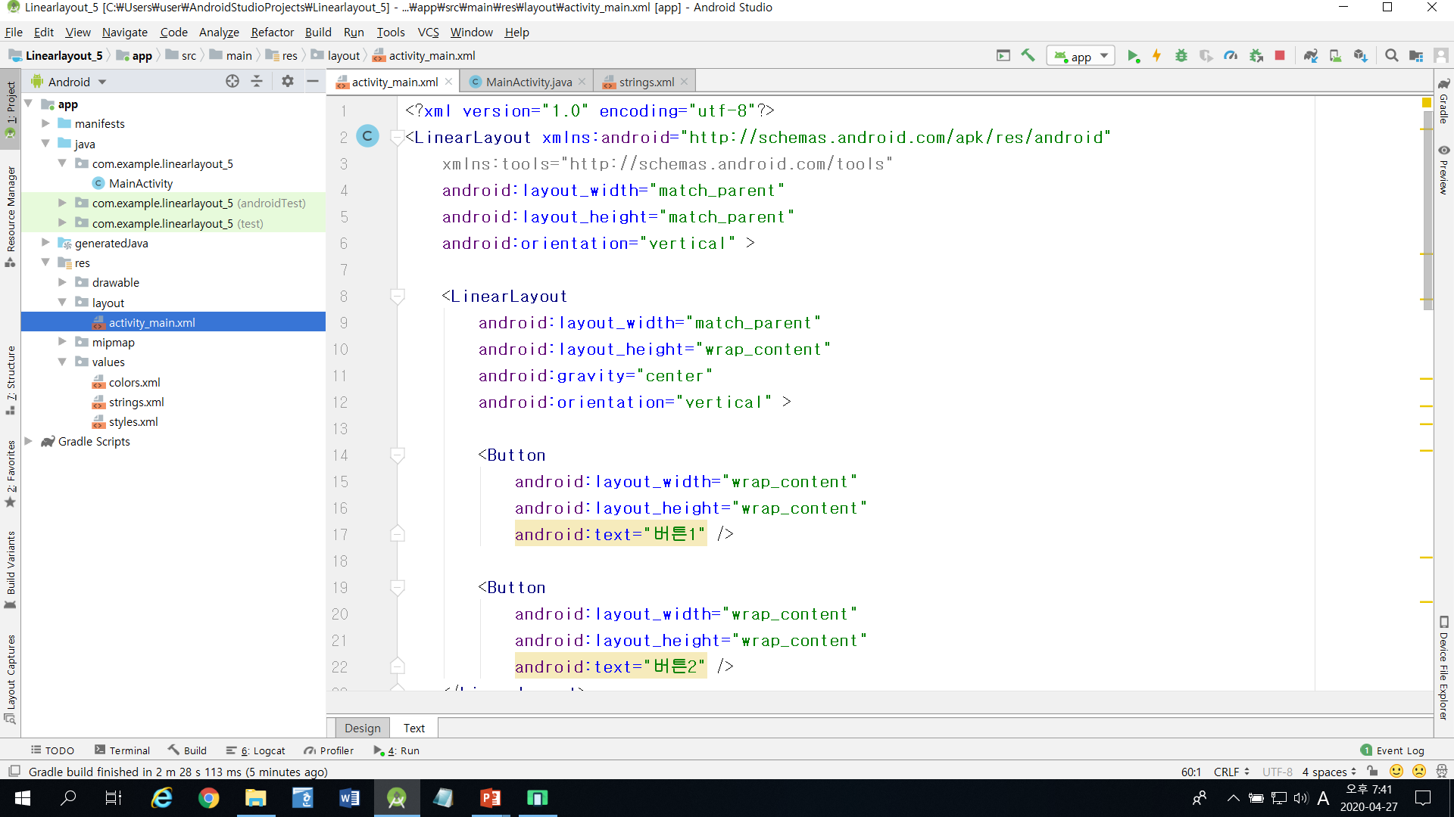

Slide 26
<?xml version="1.0" encoding="utf-8"?>
<LinearLayout xmlns:android="http://schemas.android.com/apk/res/android"
xmlns:tools="http://schemas.android.com/tools"
android:layout_width="match_parent"
android:layout_height="match_parent"
android:orientation="vertical" >
<LinearLayout
android:layout_width="match_parent"
android:layout_height="wrap_content"
android:gravity="center"
android:orientation="vertical" >
<Button
android:layout_width="wrap_content"
android:layout_height="wrap_content"
android:text="버튼1" />
<Button
android:layout_width="wrap_content"
android:layout_height="wrap_content"
android:text="버튼2" />
</LinearLayout>

Slide 27
<LinearLayout
android:layout_width="match_parent"
android:layout_height="wrap_content"
android:background="#00FF00"
android:gravity="center"
android:orientation="horizontal" >
<Button
android:layout_width="wrap_content"
android:layout_height="wrap_content"
android:text="버튼3" />
<Button
android:layout_width="wrap_content"
android:layout_height="wrap_content"
android:text="버튼4" />
</LinearLayout>

Slide 28
<LinearLayout
android:layout_width="match_parent"
android:layout_height="wrap_content"
android:background="#0000FF"
android:gravity="center"
android:orientation="vertical" >
<Button
android:layout_width="wrap_content"
android:layout_height="wrap_content"
android:text="버튼5" />
<Button
android:layout_width="wrap_content"
android:layout_height="wrap_content"
android:text="버튼6" />
</LinearLayout>
</LinearLayout>

Slide 29
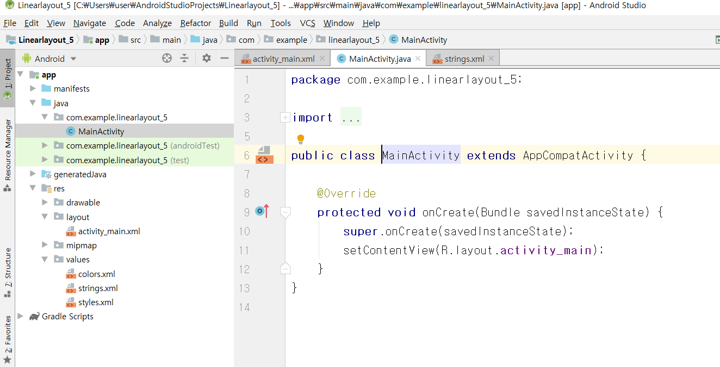
[MainActivity.java]

Slide 30
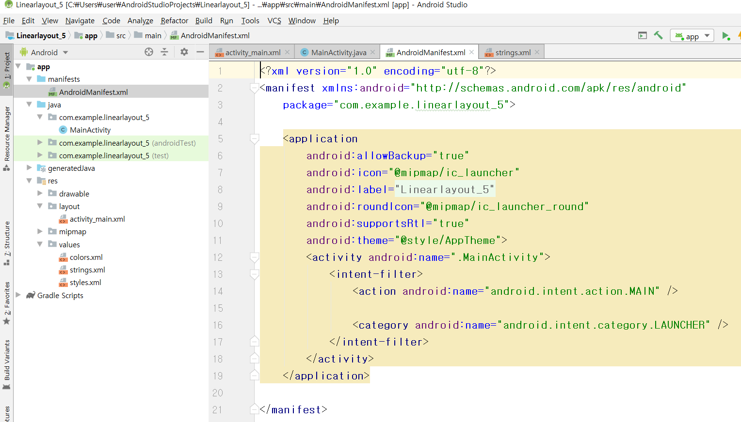
[AndroidManifest.xml]

Slide 31
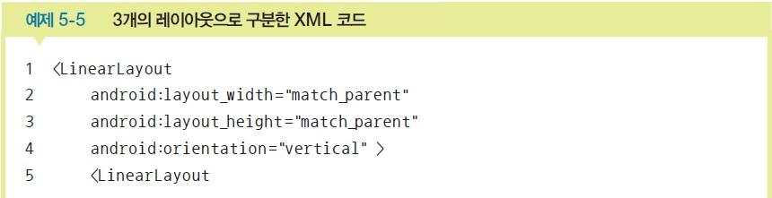
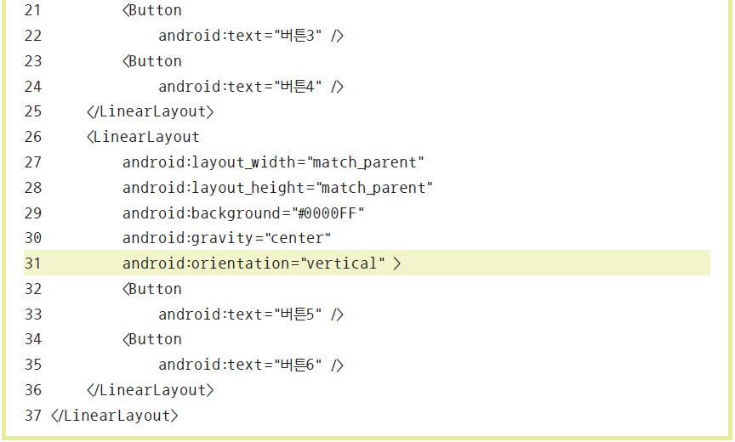
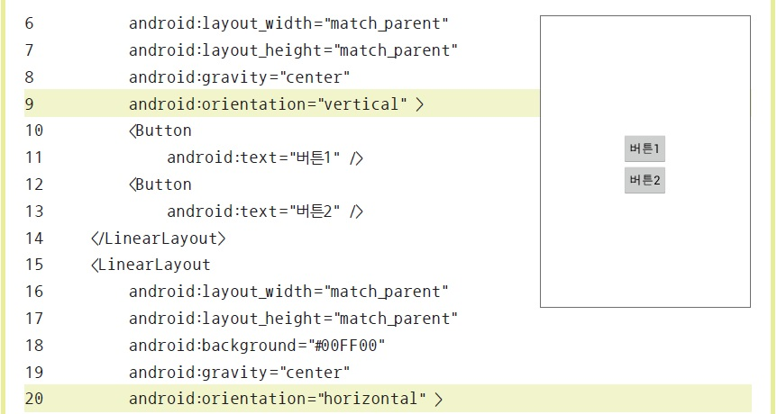
layout_weight 속성
리니어레이아웃을 여러 개 사용할 경우 각 레이아웃의 크기를 지정할 때 사용

Slide 32
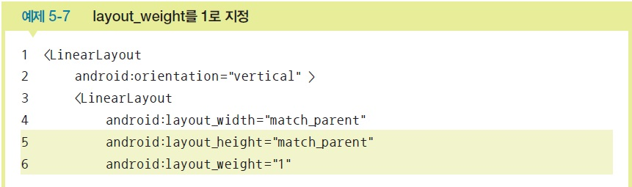
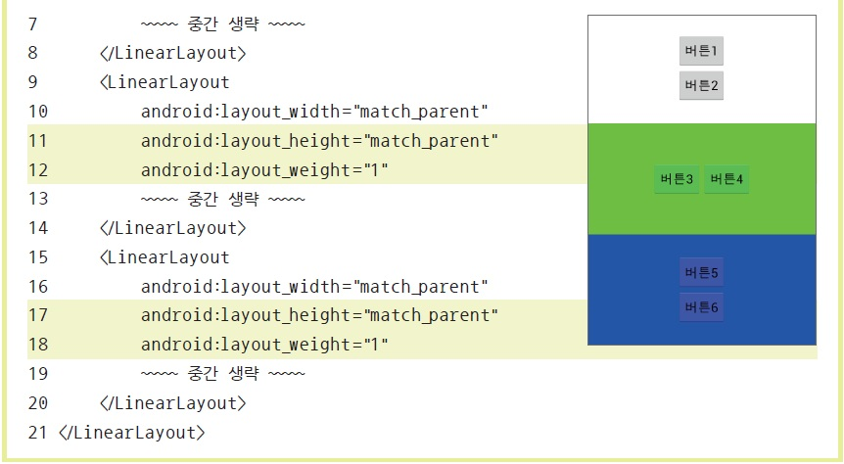
layout_weight를 1로 지정

Slide 33
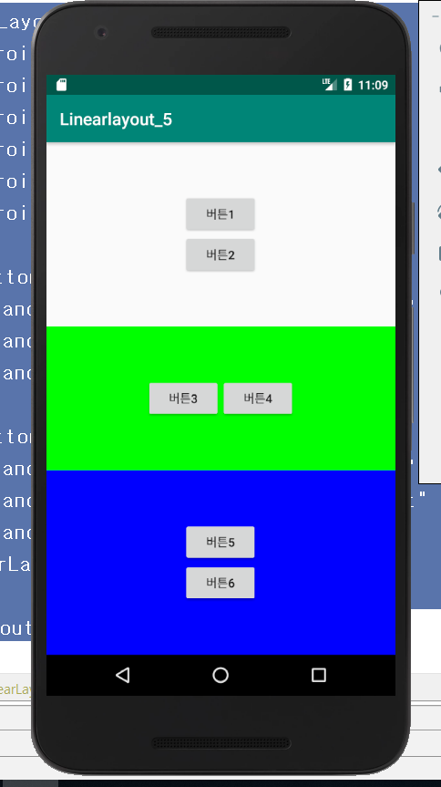
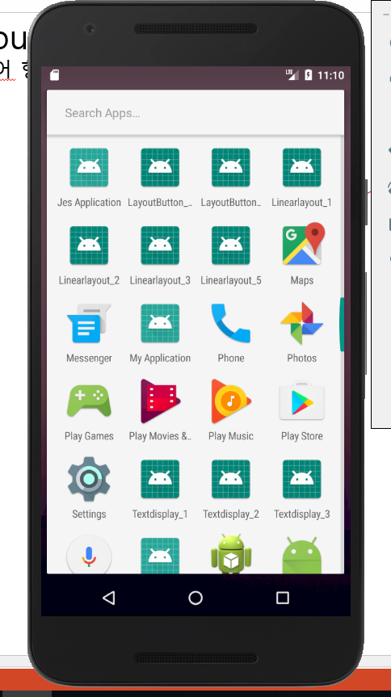
리니어Layout설계실습-6
중복리니어 weight 형태로 배치

Slide 34
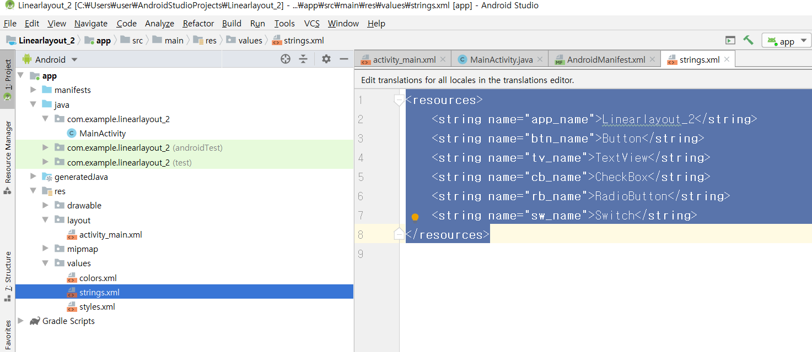
[string.xml]

Slide 35

<resources>
<string name="app_name">Linearlayout_2</string>
<string name="btn_name">Button</string>
<string name="tv_name">TextView</string>
<string name="cb_name">CheckBox</string>
<string name="rb_name">RadioButton</string>
<string name="sw_name">Switch</string>
</resources>

Slide 36
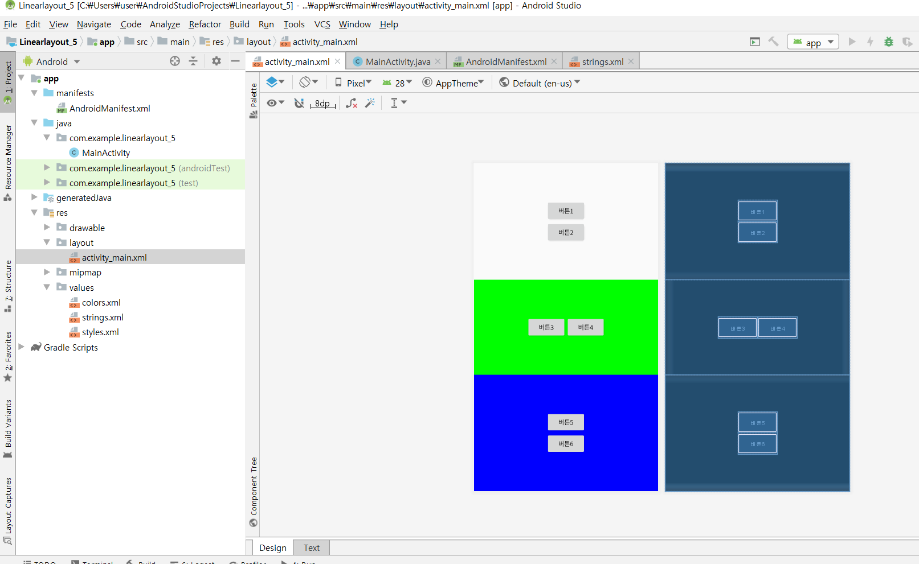
[activity_main.xml]

Slide 37
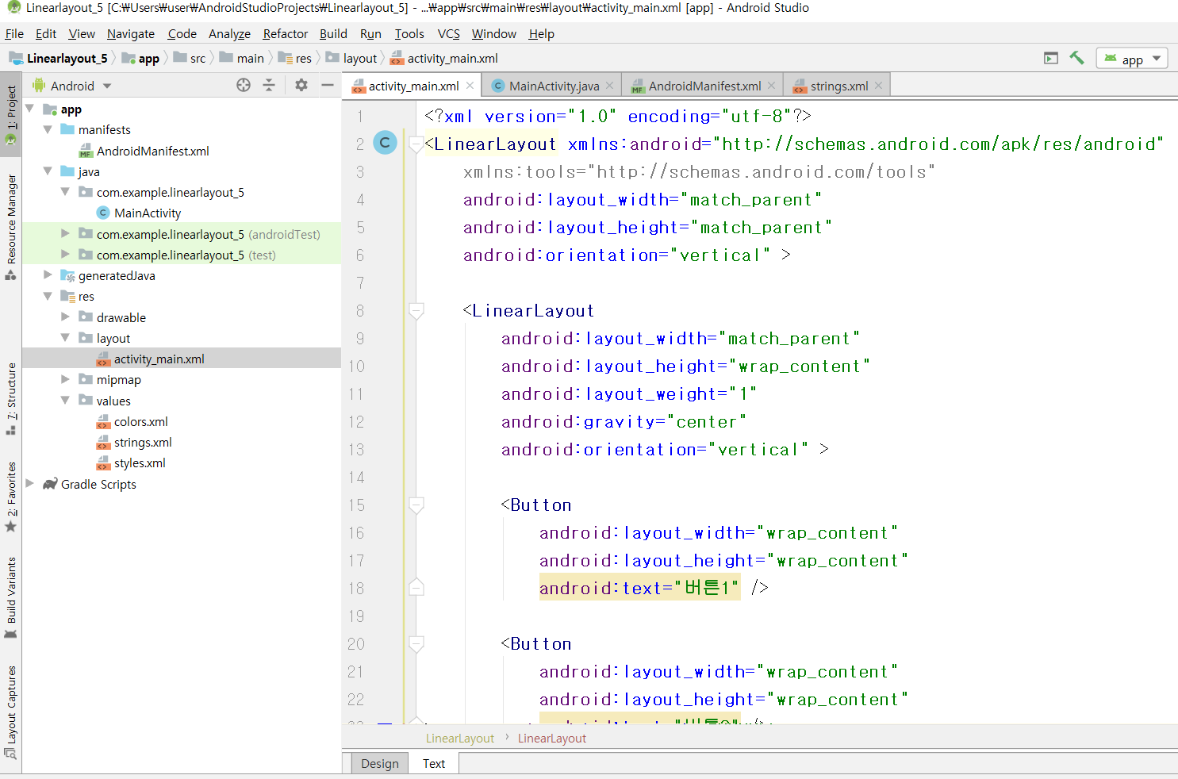

Slide 38
<?xml version="1.0" encoding="utf-8"?>
<LinearLayout xmlns:android="http://schemas.android.com/apk/res/android"
xmlns:tools="http://schemas.android.com/tools"
android:layout_width="match_parent"
android:layout_height="match_parent"
android:orientation="vertical" >
<LinearLayout
android:layout_width="match_parent"
android:layout_height="wrap_content"
android:layout_weight="1"
android:gravity="center"
android:orientation="vertical" >
<Button
android:layout_width="wrap_content"
android:layout_height="wrap_content"
android:text="버튼1" />
<Button
android:layout_width="wrap_content"
android:layout_height="wrap_content"
android:text="버튼2" />
</LinearLayout>

Slide 39
<LinearLayout
android:layout_width="match_parent"
android:layout_height="wrap_content"
android:layout_weight="1"
android:background="#00FF00"
android:gravity="center"
android:orientation="horizontal" >
<Button
android:layout_width="wrap_content"
android:layout_height="wrap_content"
android:text="버튼3" />
<Button
android:layout_width="wrap_content"
android:layout_height="wrap_content"
android:text="버튼4" />
</LinearLayout>

Slide 40
<LinearLayout
android:layout_width="match_parent"
android:layout_height="wrap_content"
android:layout_weight="1"
android:background="#0000FF"
android:gravity="center"
android:orientation="vertical" >
<Button
android:layout_width="wrap_content"
android:layout_height="wrap_content"
android:text="버튼5" />
<Button
android:layout_width="wrap_content"
android:layout_height="wrap_content"
android:text="버튼6" />
</LinearLayout>
</LinearLayout>

Slide 41
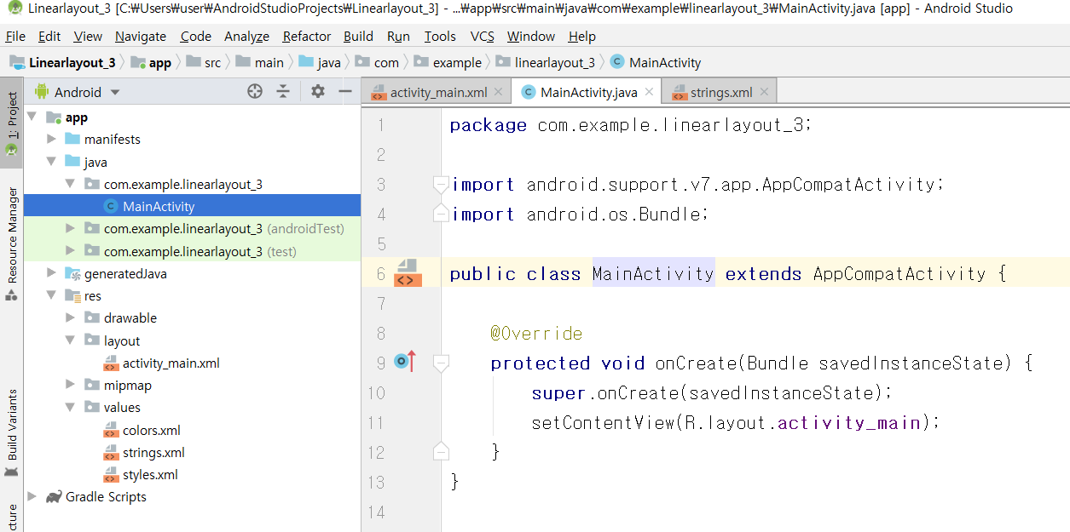
[MainActivity.java]

Slide 42
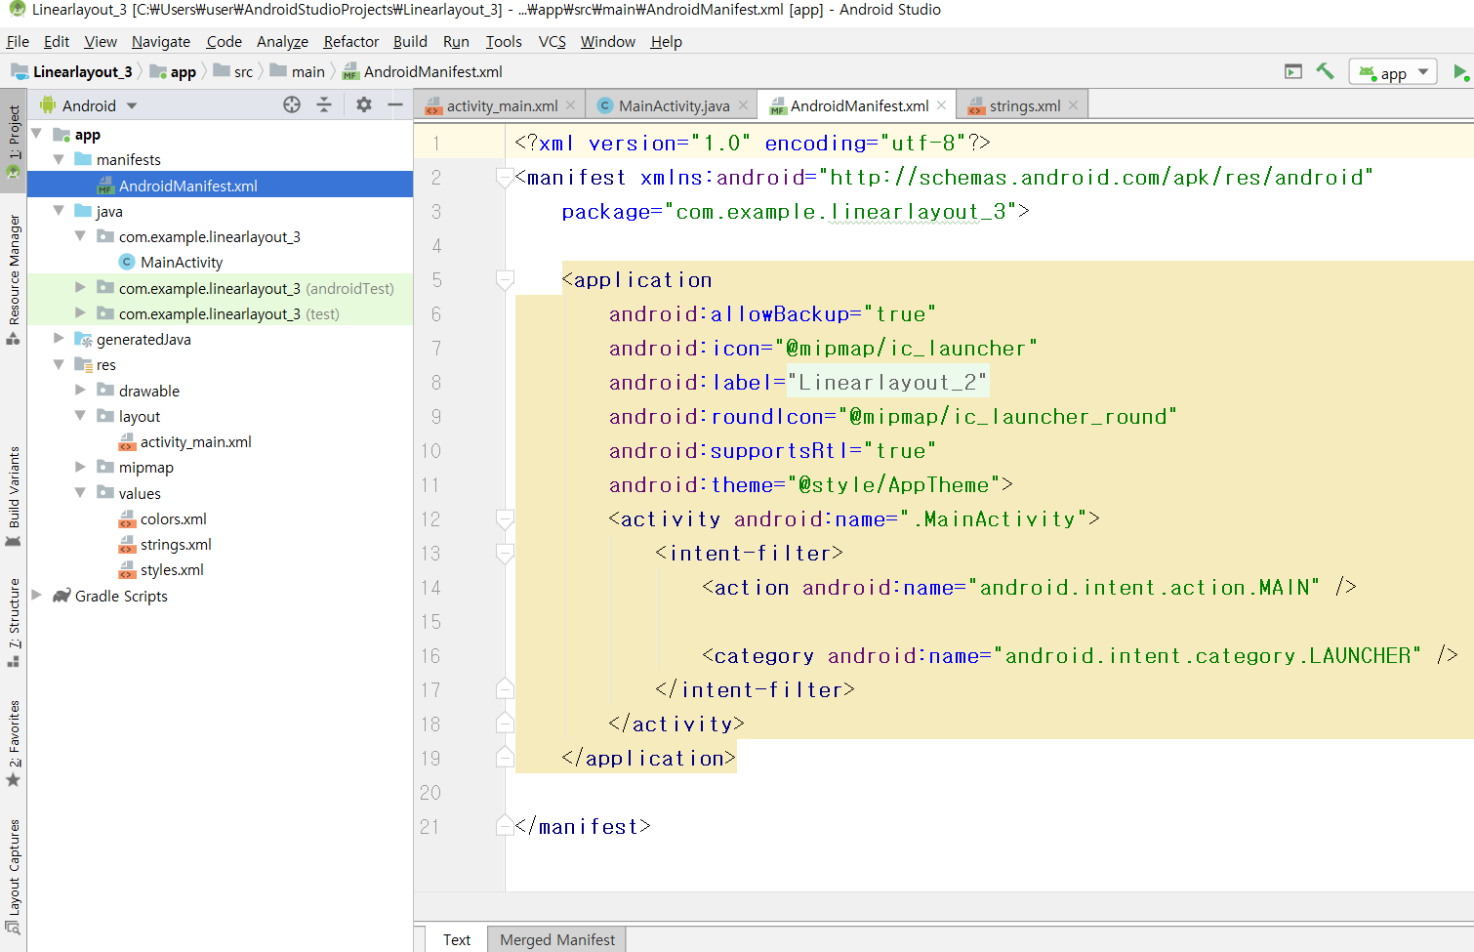
[AndroidManifest.xml]

